Slide 1
Binary Logic
Consider a system operating with 5 volt supply..
0 volt output would correspond to binary 0
5 volt output would correspond to binary 1
In reality, there are tolerances associated with these and..
3 to 5 volts would be considered a 1
0 to 0.75 volts would be considered a 0

Slide 2
Chapter 0 section 2
A Digital Primer

Slide 3
Logic Gates
These are simple circuits which produce an output from one or more inputs
Here are some common ones
And
Or
Tri State Buffer
Inverter
XOR
Nand
Nor

Slide 4
And Gate
This gate produces a 1 only when both inputs are equal to 1.
It is denoted by this symbol
Here is its truth table
Note that the output is only “true” when both inputs are “true”
Inputs |  | Outputs
X | Y | X and Y
0 | 0 | 0
0 | 1 | 0
1 | 0 | 0
1 | 1 | 1

Slide 5

Or Gate
Its output is high if either input is or both inputs are high.
It is denoted by
Here is its truth table:
Inputs |  | Output
X | Y | X OR Y
0 | 0 | 0
0 | 1 | 1
1 | 0 | 1
1 | 1 | 1

Slide 6


Tri State Buffer
A buffer gate does not change the signal its function is to isolate or amplify the input.
Here is its symbol:
Buffers are typically used to amplify the output of a particular gate to many inputs of other gate.
A Tri State Buffer Allows us to control when we output the amplified input.
Here is its symbol

Slide 7

Inverter
Also called a not gate.
It outputs a value opposite to the input.
Here is its symbol:
Here is its truth table
Input | Output
X | Not X
0 | 1
1 | 0

Slide 8

Exclusive Or – XOR
This logic gate produces a true output if and only if 1 input is true.
Here is its symbol:
Here is its truth table
Inputs |  | Output
X | Y | X XOR Y
0 | 0 | 0
0 | 1 | 1
1 | 0 | 1
1 | 1 | 0

Slide 9

NAND Gate
This gate functions like an And gate with an inverter on the output. It outputs false when both inputs are true otherwise it outputs true
Here is its symbol:
Here is its truth table
Inputs |  | Output
X | Y | X NAND Y
0 | 0 | 1
1 | 0 | 1
0 | 1 | 1
1 | 1 | 0

Slide 10

NOR Gate
NAND and NOR Gates may be used to implement any circuit which is a combination of AND, OR, XOR, and INVERTER GATES
In a NOR gate, if any input is true, the output is false, it will only produce a true output if both inputs are false.
Here is its symbol:
Here is its truth Table.
Inputs |  | Outputs
X | Y | X NOR Y
0 | 0 | 1
1 | 0 | 0
0 | 1 | 0
1 | 1 | 0

Slide 11
Logic Design using Gates
Note that there are 4 possible outcomes when adding a pair of binary numbers
0 + 0 = carry 0, sum 0
0 + 1 = carry 0, sum 1
1 + 0 = carry 0, sum 1
1 +1 = carry 1, sum 0
Recall that the AND gate only outputs 1 if both inputs are true, thus it could be used to output the carry bit.
Recall that the XOR gate only outputs 1 if and only if one of the inputs are true.

Slide 12


Half Adder Using XOR and AND Gates
Sum
Carry

Slide 13


Another Form of Half Adder Using AND, OR and Inverter
x
y
Sum
x
y
x
Carry
y

Slide 14
The Previous Half Adder Explained
And gate output will only be true if both inputs are true.
Carry bit is true for x and y equal 1,1
For 0,0 input, input to OR gate is 0,0 ; Sum is 0
For 0,1 input, input to OR gate is 1,0 ; Sum is 1
For 1,0 input, input to OR gate is 0,1 ; Sum is 1
For 11 input, input to OR gate is 0,0 ; Sum is 0

Slide 15
Block Diagram View of Half Adder
x
Sum
Half
Adder
y
Carry

Slide 16
Combing 2 Half Adders; Full Adder 3 Bit Input
x
Half
Adder
Carry
y
Final
Carry
Sum
Carry
Half
Adder
c
Final
Sum

Slide 17
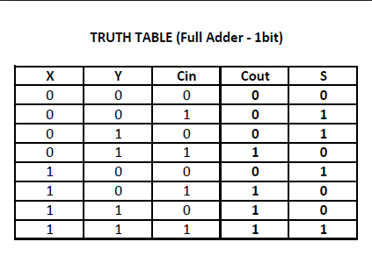
Full Adder Truth Table

Slide 18
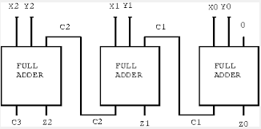
3 Bit Adder Using 3 Full adders

Slide 19
Application of the previous 3 Bit Adder
Assume we want to add the binary numbers 010 and 011..
Using the truth table from a couple of slides before..
We know that 0+1 with no carry in will result in Sum of 1 with no carry
Also, 1+1 with no carry in will result in sum of 0 with carry out of 1
Finally, 0+0 with carry in will result in sum of 1 with no carry
Result is 0101
The take away here is that we can cascade as many full adders as we want to add as large of a pair of binary numbers as we want.
For example a 64 bit sum would require 64 cascaded adders

Slide 20
Decoders
Converts Binary Input to 0,1
Consider Binary representation of 6 decimal (0110)
Output is 1 IFF input is 0110

Slide 21
D Flip-Flop
Used to latch data out is stable at either 0 or 1. One input is used to toggle the device
D
Q
Clk
Q

